Slide 1
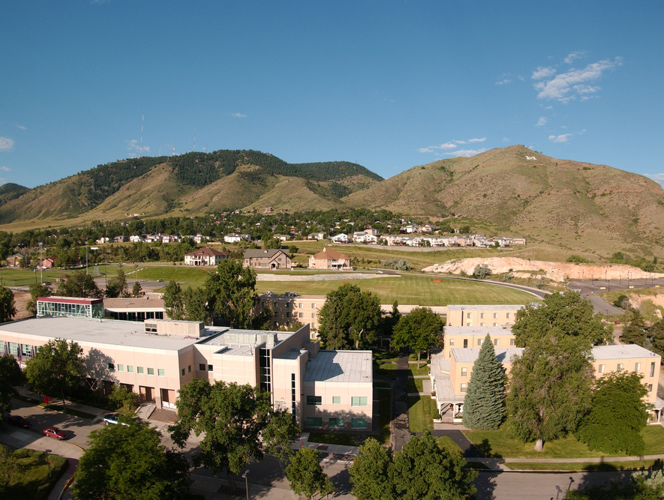
Colorado School of Mines
Computer Vision
Professor William Hoff
Dept of Computer Science
http://inside.mines.edu/~whoff/

Slide 2
Camera Calibration

Slide 3
Example Motivation
Given a 3D point in the scene, what pixel does it project to?
Using a pinhole camera: x = f X/Z, y = f Y/Z
We need to know camera parameters
Namely, focal length f in the case of the pinhole camera
p
ray
P

Slide 4
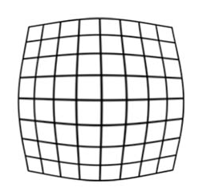

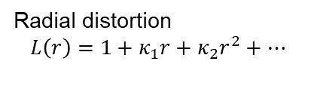
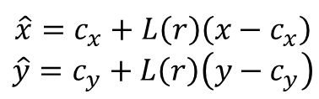
General Cameras
In general, cameras have additional intrinsic parameters
f_{x}, f_{y}: focal length in x and y directions
c_{x}, c_{y}: principal point
We also need lens distortion parameters (κ₁, κ₂, κ₃, … ):
$$K=\left(\begin{matrix}f_{x} & 0 & c_{x} \\ 0 & f_{y} & c_{y} \\ 0 & 0 & 1\end{matrix}\right)$$
Camera intrinsic matrix
correction
$$\hat{x}=c_{x}+L\left(r\right)\left(x−c_{x}\right)$$
$$\hat{y}=c_{y}+L\left(r\right)\left(y−c_{y}\right)$$
Radial distortion
$$L\left(r\right)=1+κ_{1}r+κ_{2}r^{2}+…$$
undistorted image
barrel distortion

Slide 5
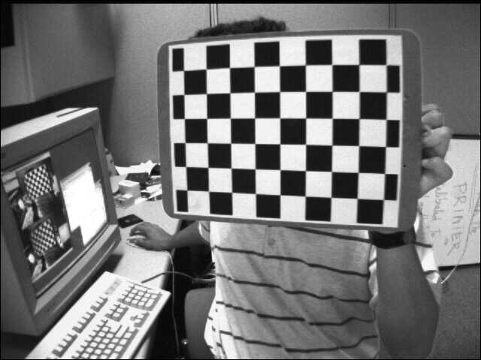
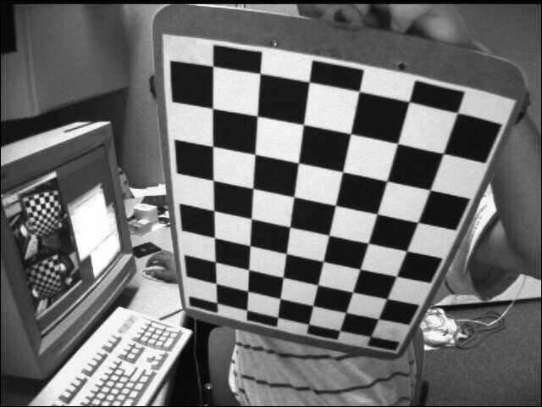
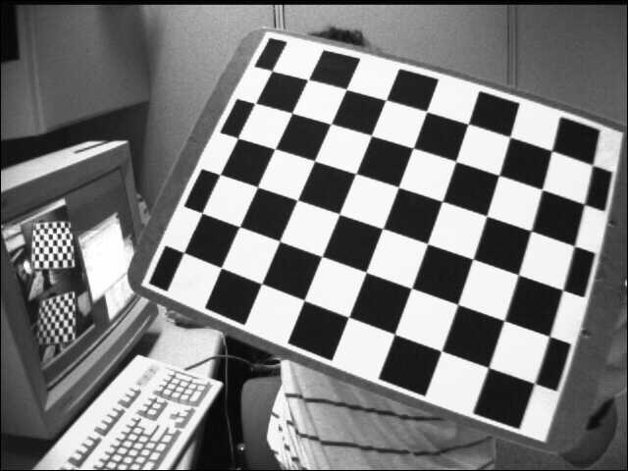
Calibration Method
Take pictures of a calibration target
A planar target is often used (it is easy to make)
Take multiple images at different (unknown) poses
Processing
Find corners (or centers of circles)
Find projection matrices for each image
Decompose to find poses and K
Iterative optimization to find lens distortion
Tips:
Take at least 10 images
Different viewpoints
Try to fill field of view

Slide 6
Simple Perspective Projection
A 3x4 camera projection matrix M projects 3D points onto 2D image points
This matrix models:
rotation and translation
focal length
ratio of pixel height and width
image center
It doesn’t model lens distortion
But first, let’s ignore lens distortion
2D image point (x,y)
3D point in world coords
3x3 intrinsic parameter matrix
3x4 extrinsic parameter matrix, contains world to camera pose

Slide 7
Perspective projection
If the target is planar, we can use Z=0 for all points on the target
So equation simplifies to

Slide 8
Perspective projection of a plane (continued)
We can solve for the 9 unknowns (m₁₁..m₃₄) by observing a set of known points on a calibration planar target, then do least squares fitting
This is called the “direct linear transformation” (DLT)
To do this, write:
Then

Slide 9
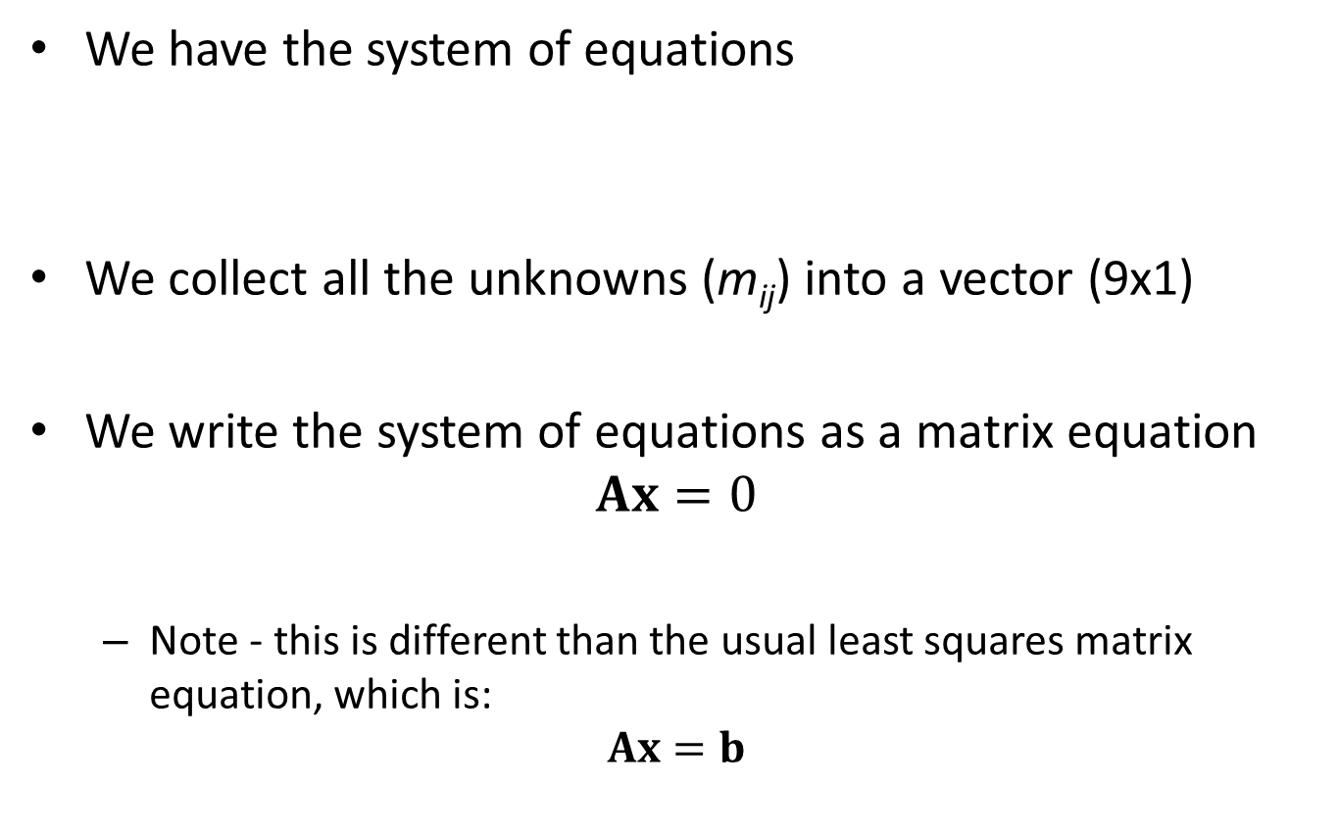
Solve using least squares
We have the system of equations
We collect all the unknowns (m_{ij}) into a vector (9x1)
We write the system of equations as a matrix equation
$$Ax=0$$
Note - this is different than the usual least squares matrix equation, which is:
$$Ax=b$$

Slide 10
Solving a System of Homogeneous Equations
We want to solve a system of m linear equations in n unknowns, of the form Ax = 0
Since the right hand sides are all zero, these are called “homogeneous equations”
The solution x is the eigenvector corresponding to the only zero eigenvalue of A^{T}A
(Proof is beyond the scope of this course)
Of course, x=0 is also a solution (but not interesting)
Note that any scaled version of x is also a solution

Slide 11
Extracting parameters
Now we have a vector x containing the nine values from the 3x3 matrix M for that image
We do this for each input image
From these, Zhang (2000) shows how to recover the calibration matrix K
Zhang, Z. (2000). A flexible new technique for camera calibration. IEEE Trans on Pattern Analysis &Machine Intel, 22(11):1330–1334.
http://staff.fh-hagenberg.at/burger/publications/reports/2016Calibration/Burger-CameraCalibration-20160516.pdf
The result from that is that we all intrinsic and extrinsic parameters except lens distortion
The intrinsic parameters (in K) are fx, fy, cx, cy
The extrinsic parameters (in each M_{ext}) are r11, r12, …, r33, tx, ty, tz

Slide 12
Lens Distortion
Lens distortion: projected points do not follow the simple pinhole camera formula
Most common is barrel distortion and pin-cushion distortion
Points are displaced radially inward (barrel) or outward (pincushion) from correct position
Tangential distortions are also possible
There are other types of lens aberrations that we won’t consider
Spherical, coma, astigmatism (these blur the point)
Chromatic aberrations (color affects focal length)

Slide 13
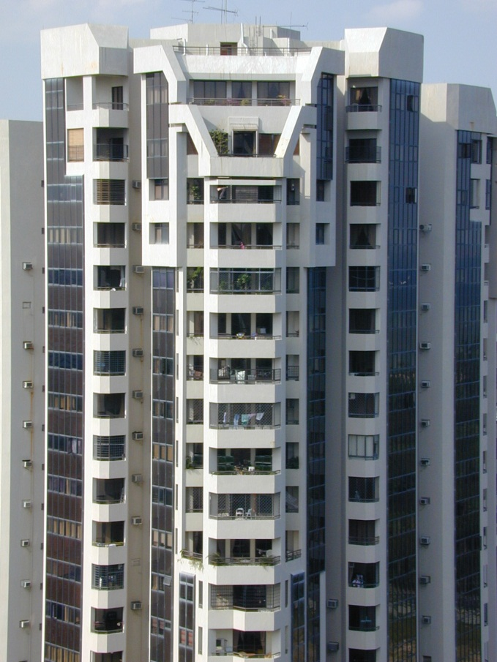
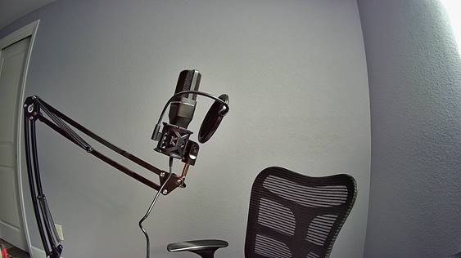
Radial Distortion Examples
wideangle (barrel)
telephoto (pincushion)
Image from Sebastian Thrun

Slide 14
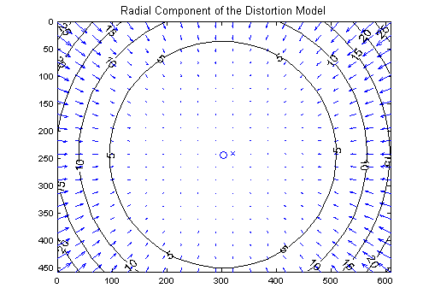
Model of Radial Distortion

Slide 15
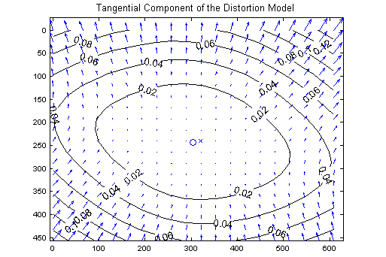
Model of Tangential Distortion

Slide 16
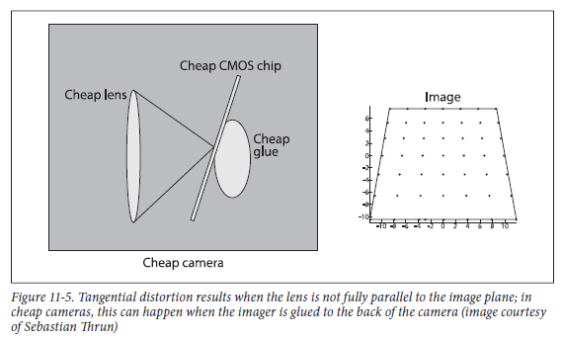

Slide 17
Complete Projection Model
A 3D point is projected onto the image plane (x,y) using the pinhole model
Then the point is distorted using
Then compute pixel location
Note: f1 and f2 are focal lengths expressed in units of horizontal and vertical pixels. Both components are usually very similar.
The ratio f2/f1, often called "aspect ratio", is different from 1 if the pixels in the CCD array are not square
There are a total of 9 parameters to be calibrated
f1,f2, cc1, cc2, k1..k5

Slide 18
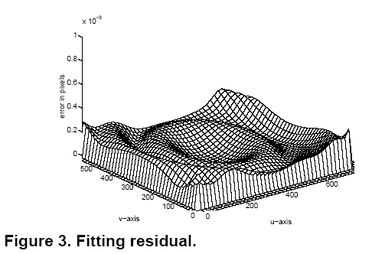
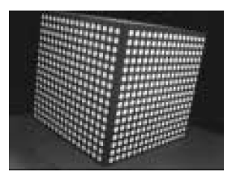
Solving for Parameters
Typically an initial guess for pose and focal length is found, ignoring lens distortions
Then non-linear optimization to find all parameters (such as iterative least squares) … this minimizes image residual errors
from Heikkilä and Silvén

Slide 19
How Many Images are Needed?
Unknowns:
There are 9 intrinsic parameters
6 additional parameters for pose of each viewpoint
Given:
K images with M points each
Each point yields two equations
So 9+6K unknowns and 2KM equations
Need 2KM > 9+6K
Example: 3 viewpoints => 27 unknowns
Need at least 5 corners per image
Of course, more are better

Slide 20
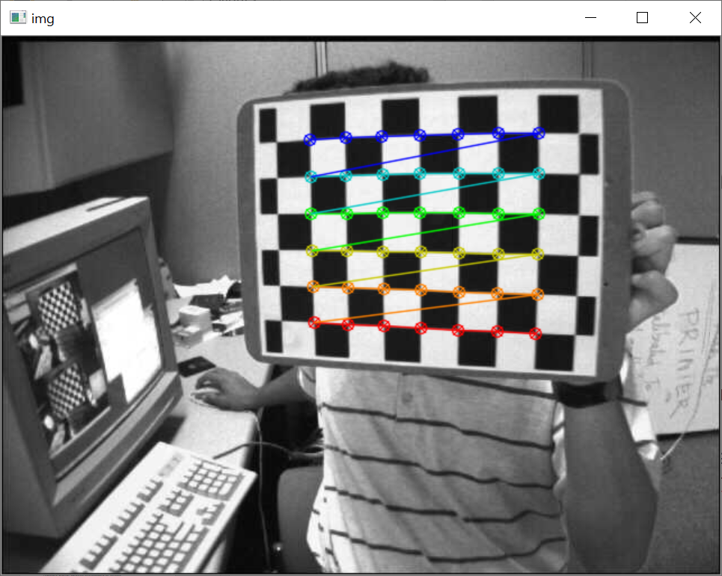
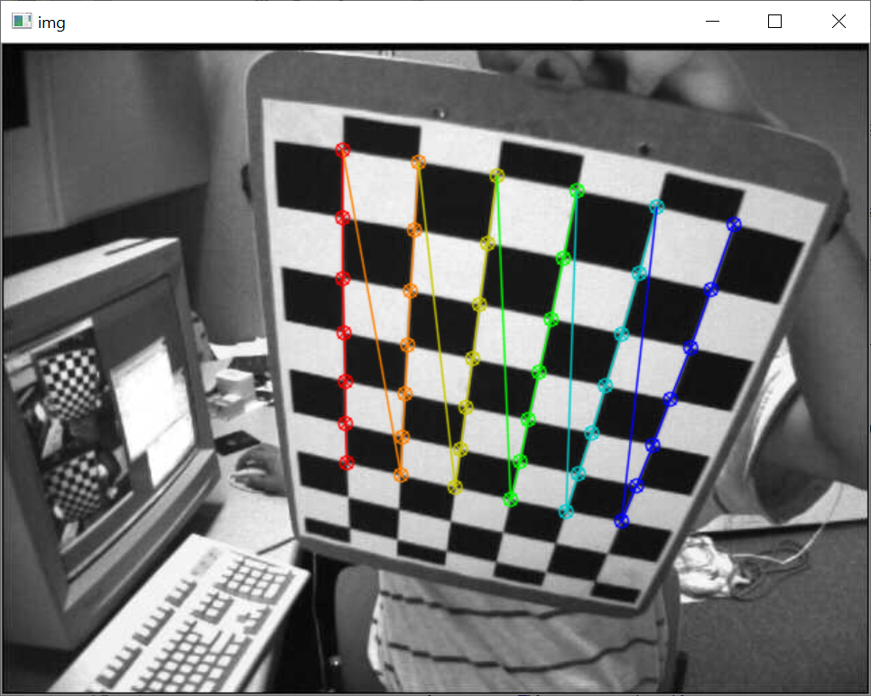
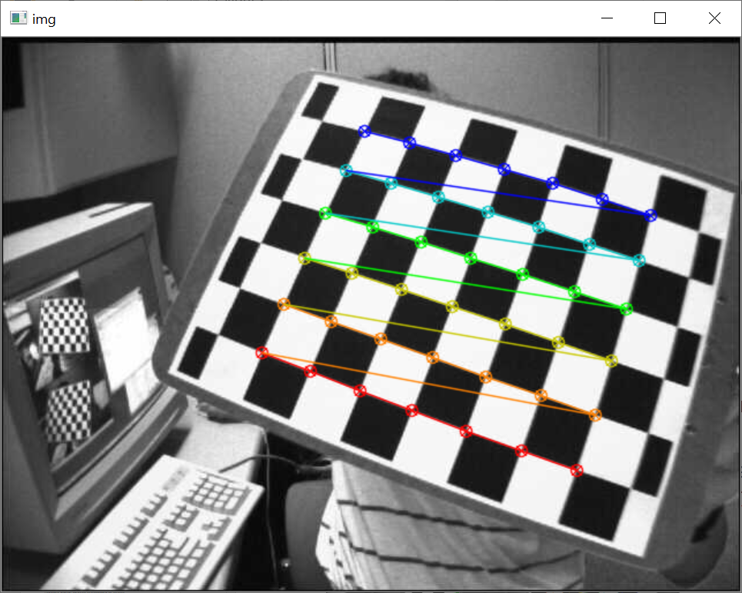
OpenCV Camera Calibration
Find corners
Draw corners
Do calibration
retval, corners=cv2.findChessboardCorners(image, patternSize)
image=cv2.drawChessboardCorners(image, patternSize,
corners, patternWasFound)
retval, K, dist, rvecs, tvecs = cv2.calibrateCamera(
objectPoints, imagePoints, imageSize, cameraMatrix, distCoeffs)
https://docs.opencv.org/master/dc/dbb/tutorial_py_calibration.html

Slide 21
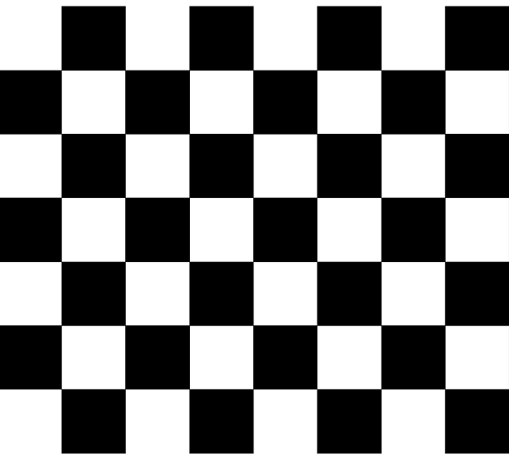
Notes on the chessboard pattern
Algorithm looks for inner corners (not the corners on the outer border)
Need to specify #rows, #columns
Algorithm wants #rows different from #columns
7x6 pattern

Slide 22
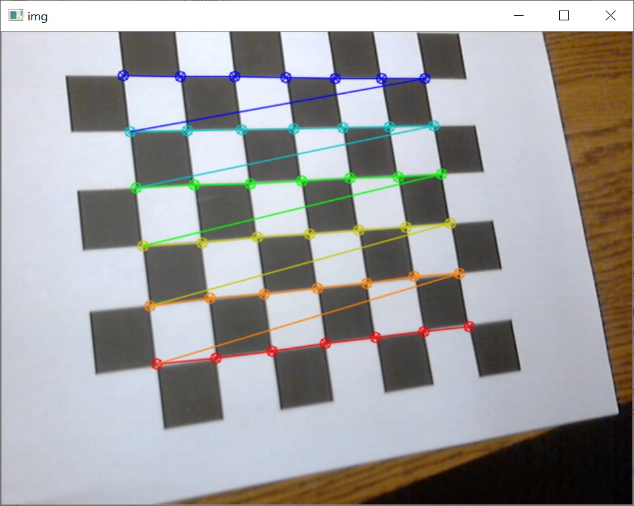
Python program – capture chessboard images
Program reads images from camera
Finds chessboard corners and draws them
Hit “ESC” to quit, any other key to capture (images saved as “img00.png”, “img01.png”, …)
main_chessboard.py

Slide 23
import cv2 import sys # This program captures images of a chessboard, finds corners, and saves the images. # Note that the chessboard must have an unequal number of rows and columns. CAMERA_NUMBER = 1 # 0 is the default camera def main(): # Initialize image capture from camera. video_capture = cv2.VideoCapture(CAMERA_NUMBER) # Open video capture object is_ok, bgr_image_input = video_capture.read() # Make sure we can read video if not is_ok: print("Cannot read video source") sys.exit() print("Hit ESC to quit; any other key to capture an image ...") imageNum = 0 while True: is_ok, bgr_image_input = video_capture.read() if not is_ok: break # no camera, or reached end of video file gray_image = cv2.cvtColor(src=bgr_image_input, code=cv2.COLOR_BGR2GRAY) # Find the chess board corners. ret_val, corners = cv2.findChessboardCorners(image=gray_image, patternSize=(7,6)) # Draw corners on a copy of the image. bgr_display = bgr_image_input.copy() cv2.drawChessboardCorners(image=bgr_display, patternSize=(7,6), corners=corners, patternWasFound=ret_val) # Wait for xx msec (0 = wait till keypress). cv2.imshow('img', bgr_display) key_pressed = cv2.waitKey(30) if key_pressed == -1: continue elif key_pressed == 27: break else: fname = "img%02d.png" % imageNum cv2.imwrite(filename=fname, img=bgr_image_input) print("Saving image %s" % fname) imageNum += 1 video_capture.release() cv2.destroyAllWindows() if __name__ == "__main__": main()
main_chessboard.py

Slide 24
Python program – calibrate camera
Program reads images from files
Finds chessboard corners and draws them
Calibrates camera from all measured corners
Writes out undistorted images
Sample output:
Camera matrix:
[[817.86372716 0. 330.25465771]
[ 0. 816.36702808 240.59539848]
[ 0. 0. 1. ]]
Distortion coeffs:
[[ 0.02727529 -0.30111803 0.0013029 -0.00256046 1.11874804]]
total error: 0.04641248456699355

Slide 25
import numpy as np import cv2 import glob # This program reads images of a chessboard, finds corners, and calibrates the camera. # The chessboard is assumed to be 7 rows and 8 columns of squares. # Create points in target coordinates; i.e., (0,0,0), (1,0,0), (2,0,0) ....,(6,5,0). # These are the inner corners of the squares. Note that it doesn't find the outer corners, so the actual # grid is 6 x 7 corners. Units don't matter because we are not interested in the absolute camera poses. target_pts = np.zeros((6 * 7, 3), np.float32) target_pts[:, :2] = np.mgrid[0:7, 0:6].T.reshape(-1, 2) # Arrays to store object points and image points from all the images. objpoints = [] # Collect all 3d points in target coordinates imgpoints = [] # Collect all 2d points in image plane images = glob.glob('*.png') # Get list of filenames in this folder for fname in images: img = cv2.imread(fname) gray_image = cv2.cvtColor(img, cv2.COLOR_BGR2GRAY) h, w = gray_image.shape # Find the chess board corners ret_val, corners = cv2.findChessboardCorners(gray_image, (7, 6), None) # If found, add object and image points. if ret_val == True: # Optionally refine corner locations. criteria = (cv2.TERM_CRITERIA_EPS + cv2.TERM_CRITERIA_MAX_ITER, 30, 0.001) corners2 = cv2.cornerSubPix(gray_image, corners, (11, 11), (-1, -1), criteria) # Collect the object and image points. objpoints.append(target_pts) imgpoints.append(corners2) # Draw and display the corners cv2.drawChessboardCorners(img, (7,6), corners2, ret_val) cv2.imshow('img', img) cv2.waitKey(0) cv2.destroyAllWindows()
main_calib.py
(1 of 2)

Slide 26
# Do the calibration. ret_val, K, dist, rvecs, tvecs = cv2.calibrateCamera( objectPoints=objpoints, imagePoints=imgpoints, imageSize=(w, h), cameraMatrix=None, distCoeffs=None) print("Camera matrix:") print(repr(K)) print("Distortion coeffs:") print(repr(dist)) # Calculate re-projection error - should be close to zero. mean_error = 0 for i in range(len(objpoints)): imgpoints2, _ = cv2.projectPoints(objpoints[i], rvecs[i], tvecs[i], K, dist) error = cv2.norm(imgpoints[i], imgpoints2, cv2.NORM_L2)/len(imgpoints2) mean_error += error print( "total error: {}".format(mean_error/len(objpoints)) ) # Optionally undistort and display the images. for fname in images: img = cv2.imread(fname) cv2.imshow("distorted", img) undistorted_img = cv2.undistort(src=img, cameraMatrix=K, distCoeffs=dist) cv2.imshow("undistorted", undistorted_img) cv2.imwrite("undistorted_" + fname, undistorted_img) if cv2.waitKey(0) == 27: # ESC is ascii code 27 break
main_calib.py
(2 of 2)

Slide 27
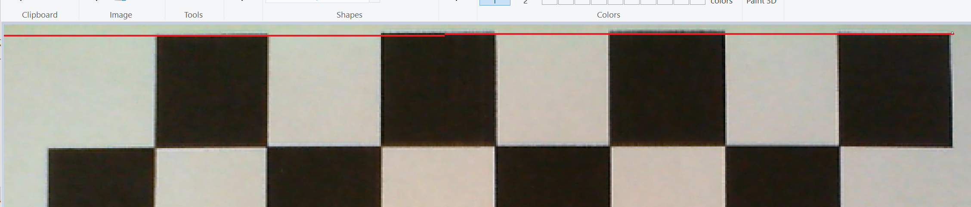
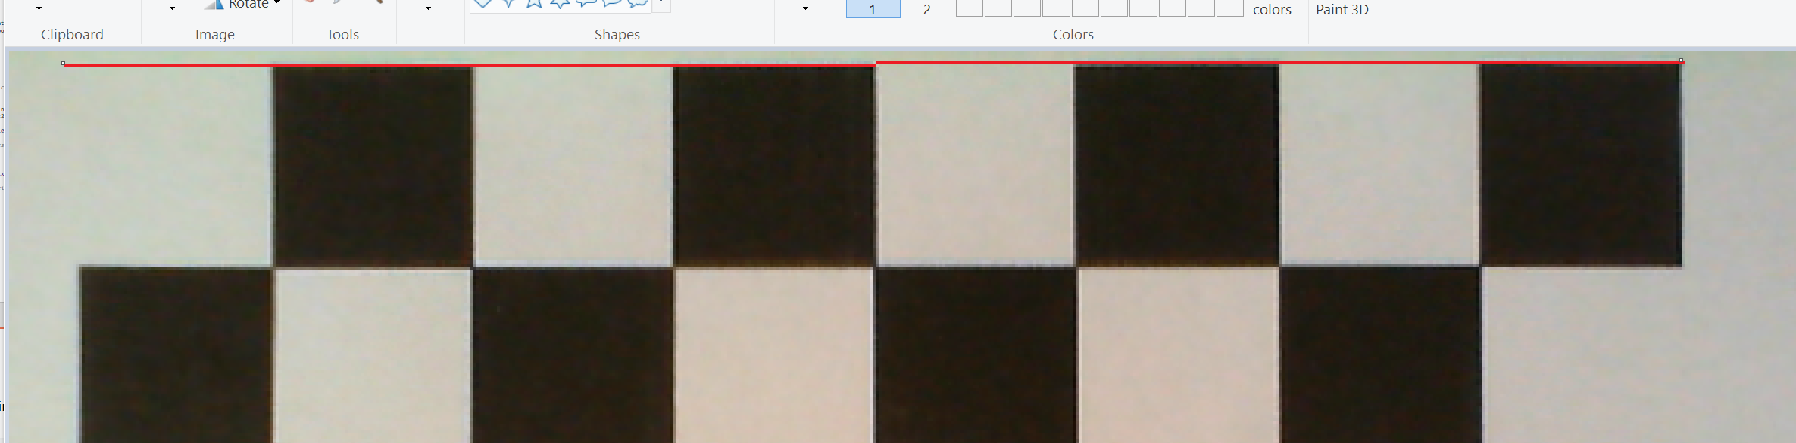
Effect of Undistortion
Draw a line on original image, using “Paint” in Windows
Draw a line on undistorted image, using “Paint” in Windows

Slide 28
Summary
Camera calibration is done to find the intrinsic parameters of the camera
Typical procedure: take multiple images of a calibration target (chessboard or grid of circles)
Algorithm finds corners, derives intrinsic parameters from corner locations

